Slide 1
CSS
Yvette Gottschalk

Slide 2
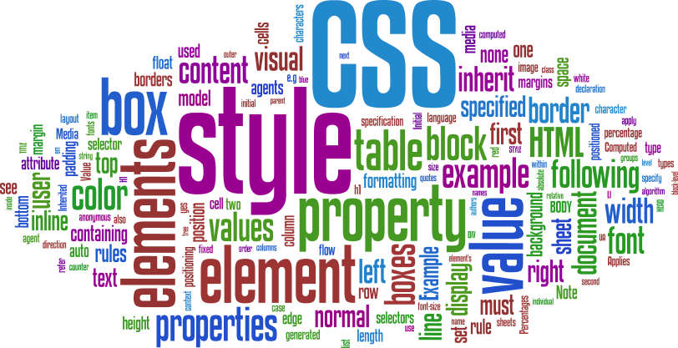
What is CSS
Cascading Style Sheets
CSS handles the look and feel part of a web page to make it presentable.
The World Wide Web Consortium (W3C) created CSS
Notes:
The World Wide Web Consortium, or W3C is a group that makes recommendations about how the Internet works and how it should evolve.
CSS was invited by Håkon Wium Lie on October 10, 1994

Slide 3

Why? (To put cats on the interwebz)

Slide 4
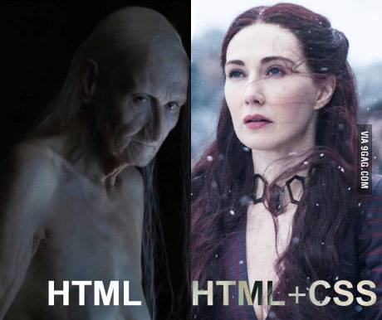
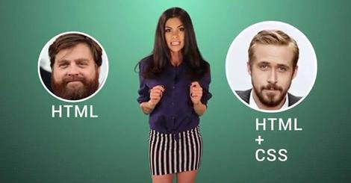

Slide 5
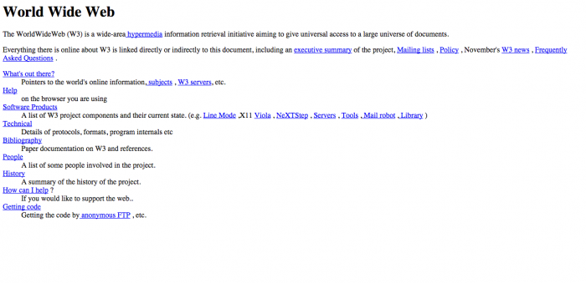
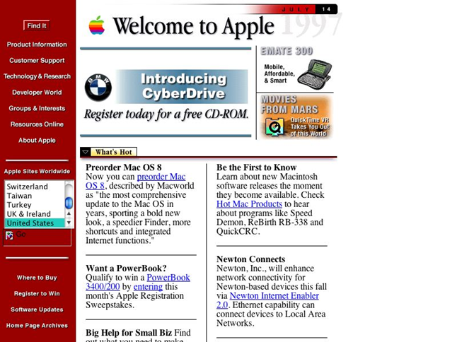
Notes:
December 1996 – CSS 1
May 1998 – CSS 2
June 2011 – CSS 2.1

Slide 6



Slide 7
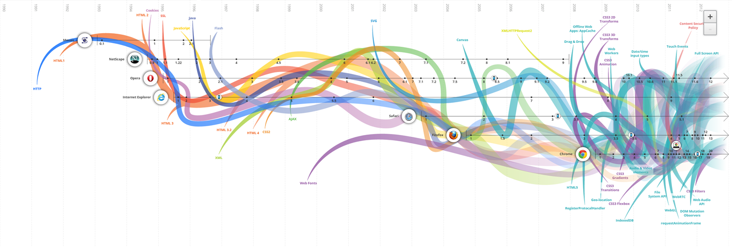
http://www.evolutionoftheweb.com/
Notes:
http://www.evolutionoftheweb.com/

Slide 8
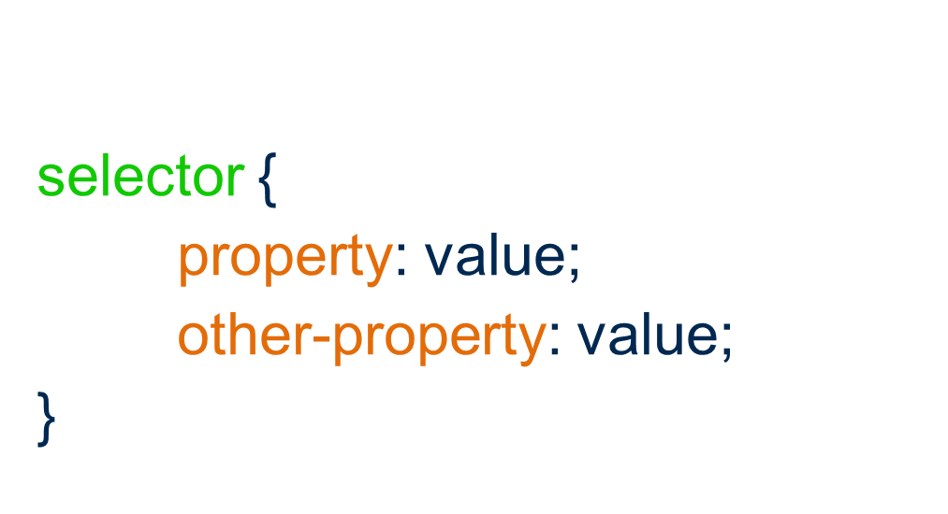
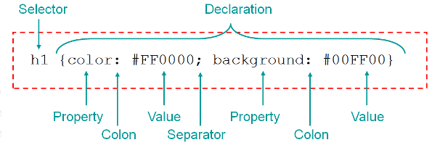
Rule Syntax

Slide 9
Adding CSS
Inline
Internal
In the html file as a separate element meta element.
External
In a separate file all together.

Slide 10
Inline CSS
<p style=”margin-left: 10px; color: #000000”>
Welcome to the dark side
</p>

Slide 11
Internal CSS
<style type=”text/css”>
p {
margin-left: 10px;
color: #000000;
}
</style>
<p>
We’ve got cookies
</p>

Slide 12
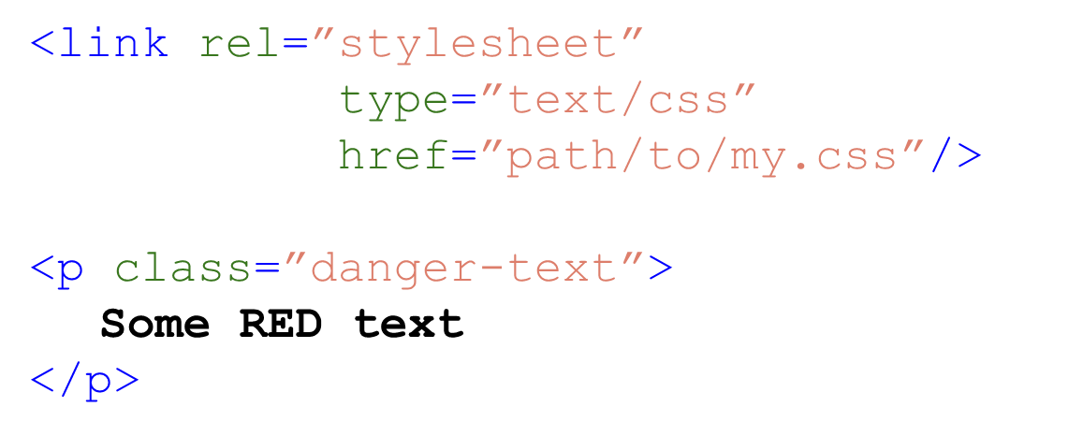
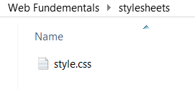
External CSS
Notes:
Explain order of precedence

Slide 13
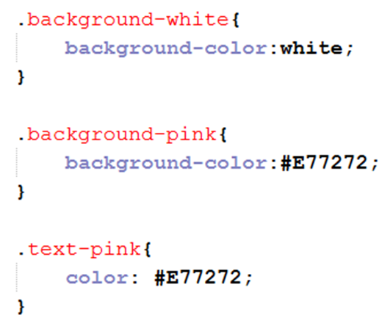
Specifying colours
a valid color name for example blue
an RGB value like rgb(0, 0, 250)
a HEX value like #0000FF
http://htmlcolorcodes.com/

Slide 14
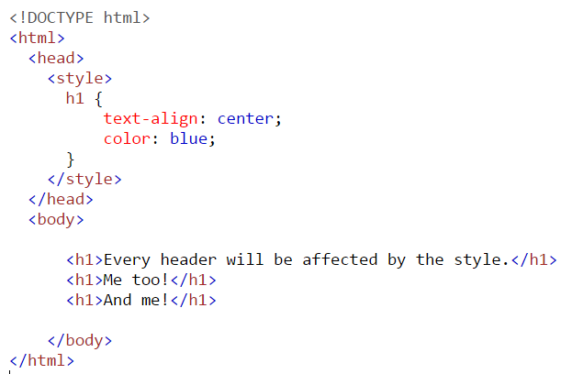
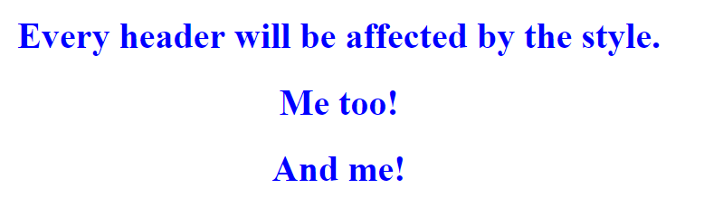
Element Selector

Slide 15
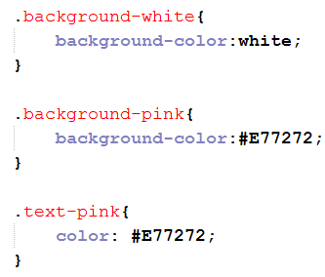
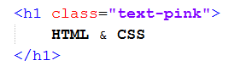

Class selector

Slide 16

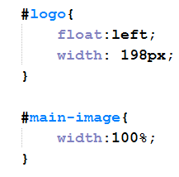
ID Selector

Slide 17
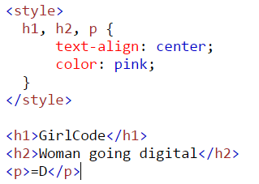

Grouping selectors

Slide 18
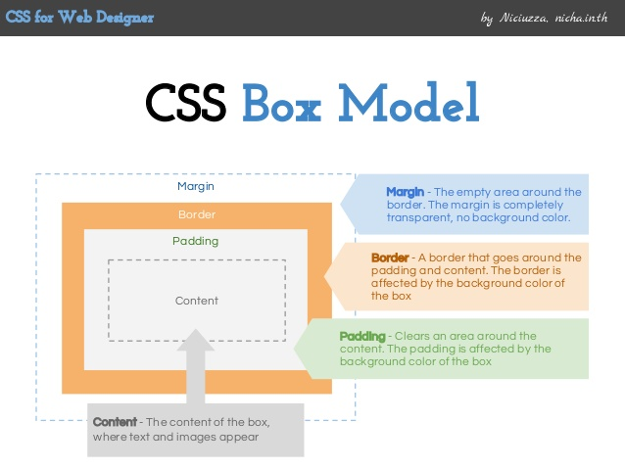
CSS Box Model

Slide 19
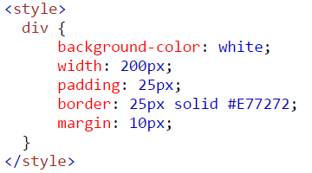
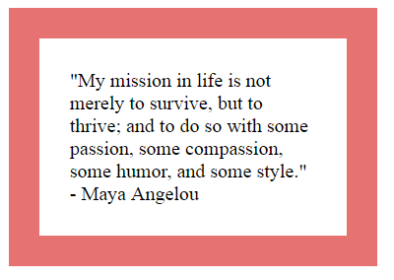
Box Model Example
https://www.w3schools.com/code/tryit.asp?filename=FCZTWD54NWC3
Notes:
https://www.w3schools.com/code/tryit.asp?filename=FCZTWD54NWC3

Slide 20
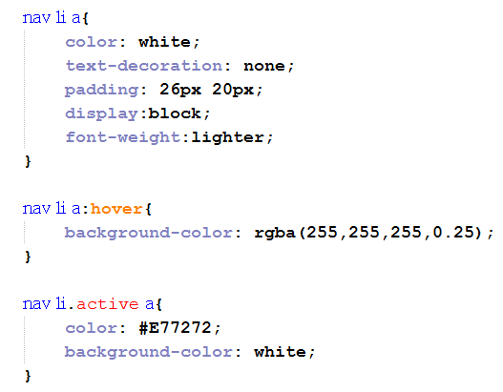
Styling links
a:link - a normal, unvisited link
a:visited - a link the user has visited
a:hover - a link when the user mouses over it
a:active - a link the moment it is clicked

Slide 21
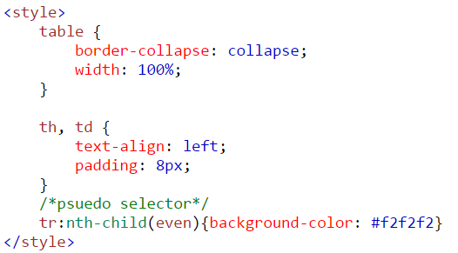
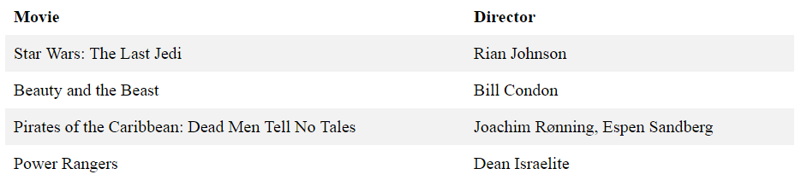
Styling tables

Slide 22
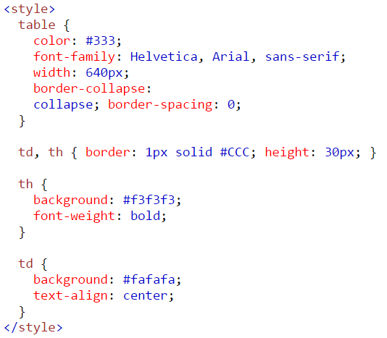

More table styles

Slide 23
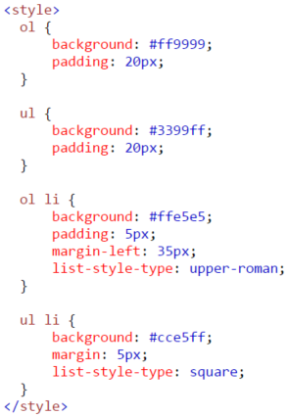
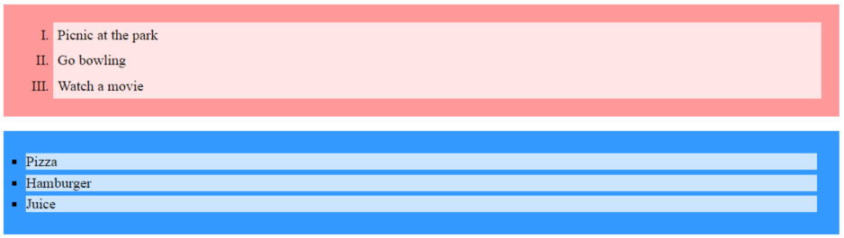
Styling Lists
Notes:
list-style-image: url('');

Slide 24
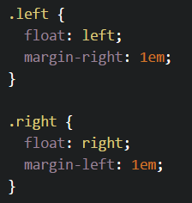
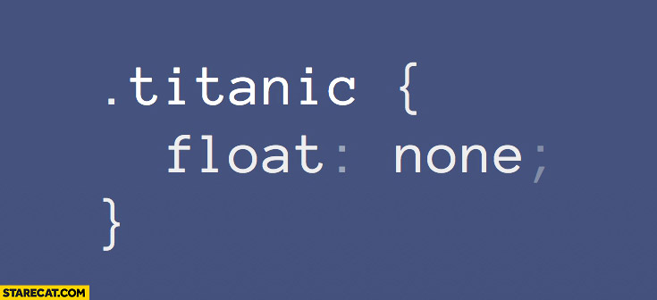
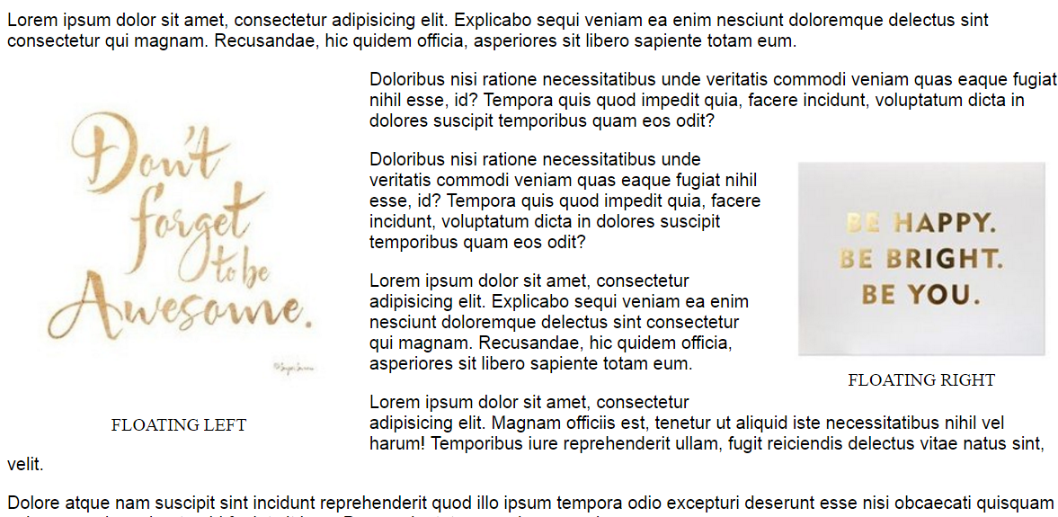
Float
Notes:
https://css-tricks.com/almanac/properties/f/float/

Slide 25
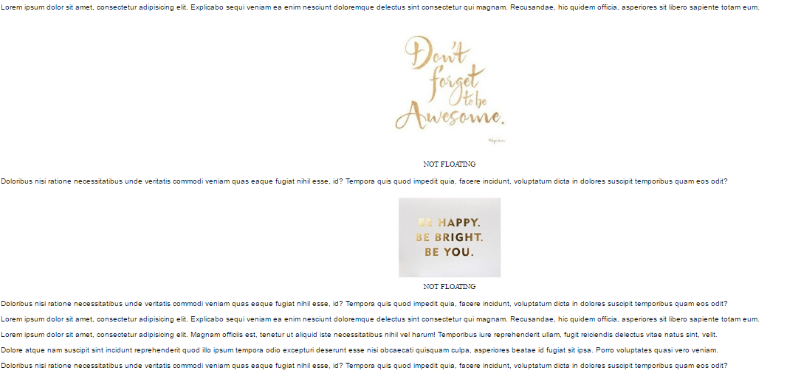
Without float

Slide 26

Separate Content from Style
Bad Code
<p style=”color: #939; font-size: 24px;”>
Thank you!
</p>

Slide 27

Separate Content from Style
Good Code
<style>
.alert-success {
color: #393;
font-size: 24px;
}
</style>
<p class=”alert-success”>
Thank you!
</p>

Slide 28
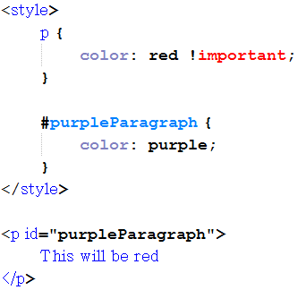
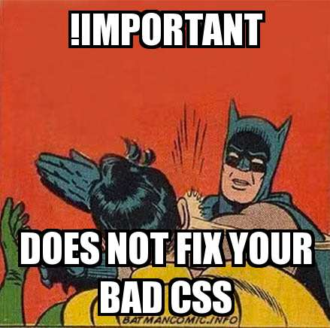
Do NOT use !important
!important overrides that particular property.
Code becomes messy and difficult to maintain

Slide 29
CSS Frameworks
In the world of web design, a framework is defined as a package made up of a structure of files and folders of standardized code (HTML, CSS, etc.) which can be used to support the development of websites, as a basis to start building a site.
Examples:
Bootstrap - http://getbootstrap.com/
Skeleton
Foundation
Material Design Lite
Many many more...

Slide 30
CSS3
Animations and Transitions
Calculating values
Advanced selectors
Gradients
Webfonts
Boxsizing
Media queries
Border images
Transforms
http://www.creativebloq.com/css3/animation-with-css3-712437

Slide 31
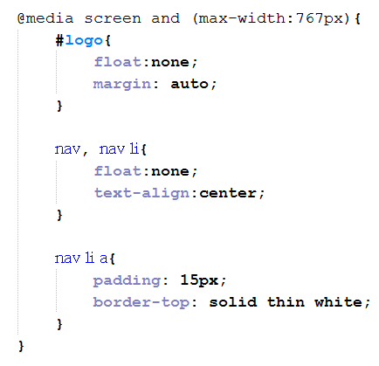
Media Queries
@media can include a media type followed by one or more expressions.
Common media types:
all
screen
print
tv
braille
The HTML5 specification includes new media types like 3d-glasses.
Should a media type not be specified the media query will use the screen media type by default

Slide 32

Icons
http://fontawesome.io/
http://glyphicons.com/

Slide 33
References & Reading Material
https://css-tricks.com/
https://www.codecademy.com/en/tracks/htmlcss
https://www.tutorialspoint.com/css/
https://www.w3schools.com/css/
http://learn.shayhowe.com/advanced-html-css/responsive-web-design/
https://developer.mozilla.org/en-US/docs/Learn/CSS

Slide 34
Practice exercise - styling
Use an element selector to style the heading and a paragraph
Use a class to style the background colour
Make use of float and an id for your profile picture
If time permits we can help you style the rest of the page. Feel free to be creative.

